Slide 1
Protection
Course Code: CSC 2209
Course Title: Operating Systems
Dept. of Computer Science
Faculty of Science and Technology
Lecturer No: | 11 | Week No: | 11 | Semester: | Summer 22-23
Lecturer: | Taslimur Rahman; Taslimur.Rahman@aiub.edu

Slide 2
Lecture Outline
Goals of Protection
Principles of Protection
Protection Rings
Domain of Protection
Access Matrix
Implementation of Access Matrix
Revocation of Access Rights
Role-based Access Control
Other Protection Implementation Methods

Slide 3
Goals of Protection
In one protection model, computer consists of a collection of objects, hardware or software
Each object has a unique name and can be accessed through a well-defined set of operations
Protection problem - ensure that each object is accessed correctly and only by those processes that are allowed to do so
Notes:
Access control of system resources (software/hardware)

Slide 4
Principles of Protection
Guiding principle – principle of least privilege
Programs, users and systems should be given just enough privileges to perform their tasks
Properly set permissions can limit damage if entity has a bug, gets abused
Can be static (during life of system, during life of process)
Or dynamic (changed by process as needed) – domain switching, privilege escalation
Compartmentalization a derivative concept regarding access to data
Process of protecting each individual system component through the use of specific permissions and access restrictions

Slide 5
Domain of Protection
Rings of protection separate functions into domains and order them hierarchically
Computer can be treated as processes and objects
Hardware objects (such as devices) and software objects (such as files, programs, semaphores
Process for example should only have access to objects it currently requires to complete its task – the need-to-know principle
Implementation can be via process operating in a protection domain
Specifies resources process may access
Each domain specifies set of objects and types of operations on them
Ability to execute an operation on an object is an access right
<object-name, rights-set>
Domains may share access rights
Associations can be static or dynamic
If dynamic, processes can domain switch

Slide 6
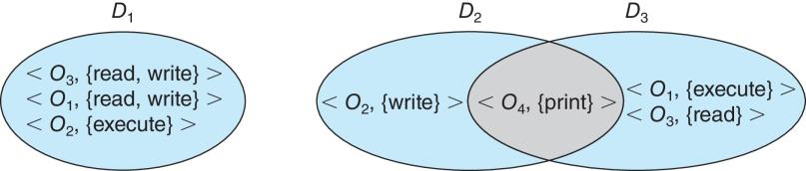
Domain Structure
Access-right = <object-name, rights-set> where rights-set is a subset of all valid operations that can be performed on the object
Domain = set of access-rights

Slide 7
Domain Implementation (UNIX)
Domain = user-id
Domain switch accomplished via file system
Each file has associated with it a domain bit (setuid bit)
When file is executed and setuid = on, then user-id is set to owner of the file being executed
When execution completes user-id is reset
Domain switch accomplished via passwords
su command temporarily switches to another user’s domain when other domain’s password provided
Domain switching via commands
sudo command prefix executes specified command in another domain (if original domain has privilege or password given)

Slide 8
Domain Implementation (Android App IDs)
In Android, distinct user IDs are provided on a per-application basis
When an application is installed, the installd daemon assigns it a distinct user ID (UID) and group ID (GID), along with a private data directory (/data/data/<appname>) whose ownership is granted to this UID/GID combination alone.
Applications on the device enjoy the same level of protection provided by UNIX systems to separate users
A quick and simple way to provide isolation, security, and privacy.
The mechanism is extended by modifying the kernel to allow certain operations (such as networking sockets) only to members of a particular GID (for example, AID INET, 3003)
A further enhancement by Android is to define certain UIDs as “isolated,” prevents them from initiating RPC requests to any but a bare minimum of services

Slide 9
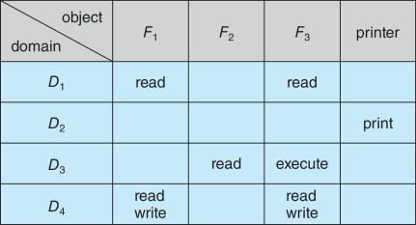
Access Matrix
View protection as a matrix (access matrix)
Rows represent domains
Columns represent objects
Access(i, j) is the set of operations that a process executing in Domain_{i} can invoke on Object_{j}
Notes:
D1
<F1, {Read}>
<F3, {Read}>
D2
<Printer, {Print}>
D3
<F2, {Read}>
D4
<F1, {Read, Write}>
<F3, {Read, Write}>

Slide 10
Use of Access Matrix
If a process in Domain D_{i} tries to do “op” on object O_{j}, then “op” must be in the access matrix
User who creates object can define access column for that object
Can be expanded to dynamic protection
Operations to add, delete access rights
Special access rights:
owner of O_{i}
copy op from O_{i} to O_{j} (denoted by “*”)
control – D_{i} can modify D_{j} access rights
transfer – switch from domain D_{i} to D_{j}
Copy and Owner applicable to an object
Control applicable to domain object

Slide 11
Use of Access Matrix (cont’d)
Access matrix design separates mechanism from policy
Mechanism
Operating system provides access-matrix + rules
If ensures that the matrix is only manipulated by authorized agents and that rules are strictly enforced
Policy
User dictates policy
Who can access what object and in what mode
But doesn’t solve the general confinement problem

Slide 12
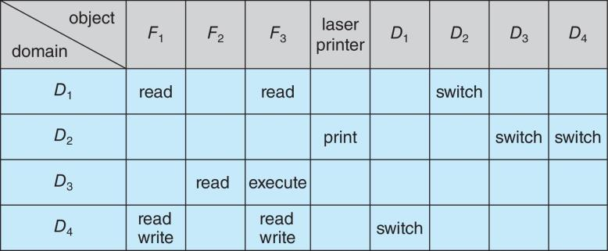
Access Matrix of Figure A with Domains as Objects

Slide 13
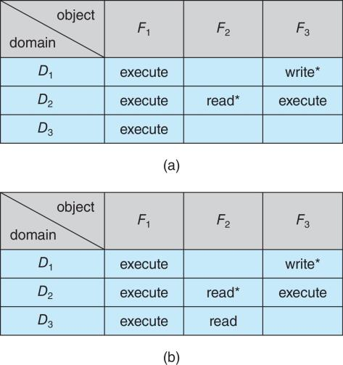
Access Matrix with Copy Rights

Slide 14
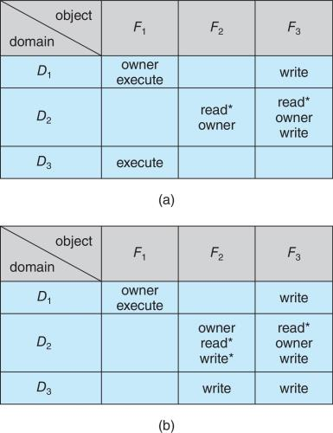
Access Matrix With Owner Rights

Slide 15
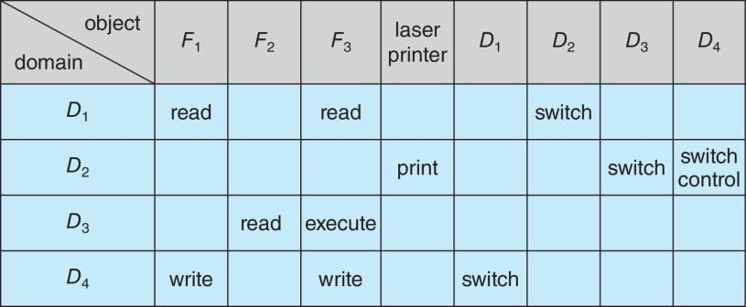
Modified Access Matrix of Figure B

Slide 16
Implementation of Access Matrix
Generally, a sparse matrix
Option 1 – Global table
Store ordered triples <domain, object, rights-set> in table
A requested operation M on object O_{j} within domain D_{i} -> search table for < D_{i}, O_{j}, R_{k} >
with M ∈ R_{k}
But table could be large -> won’t fit in main memory
Difficult to group objects (consider an object that all domains can read)

Slide 17
Implementation of Access Matrix (cont’d)
Option 2 – Access lists for objects
Each column implemented as an access list for one object
Resulting per-object list consists of ordered pairs <domain, rights-set> defining all domains with non-empty set of access rights for the object
Easily extended to contain default set -> If M ∈ default set, also allow access

Slide 18
Implementation of Access Matrix (cont’d)
Each column = Access-control list for one object Defines who can perform what operation Domain 1 = Read, Write Domain 2 = Read Domain 3 = Read
Each Row = Capability List (like a key) For each domain, what operations allowed on what objects
Object F1 – Read
Object F4 – Read, Write, Execute
Object F5 – Read, Write, Delete, Copy

Slide 19
Implementation of Access Matrix (cont’d)
Option 3 – Capability list for domains
Instead of object-based, list is domain based
Capability list for domain is list of objects together with operations allows on them
Object represented by its name or address, called a capability
Execute operation M on object O_{j}, process requests operation and specifies capability as parameter
Possession of capability means access is allowed
Capability list associated with domain but never directly accessible by domain
Rather, protected object, maintained by OS and accessed indirectly
Like a “secure pointer”
Idea can be extended up to applications

Slide 20
Implementation of Access Matrix (cont’d)
Option 4 – Lock-key
Compromise between access lists and capability lists
Each object has list of unique bit patterns, called locks
Each domain as list of unique bit patterns called keys
Process in a domain can only access object if domain has key that matches one of the locks

Slide 21
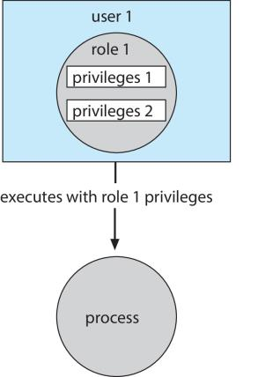
Role-based Access Control
Protection can be applied to non-file resources
Oracle Solaris 10 provides role-based access control (RBAC) to implement least privilege
Privilege is right to execute system call or use an option within a system call
Can be assigned to processes
Users assigned roles granting access to privileges and programs
Enable role via password to gain its privileges
Similar to access matrix

Slide 22
Other Protection Improvement Methods
System integrity protection (SIP)
Introduced by Apple in macOS 10.11
Restricts access to system files and resources, even by root
Uses extended file attribs to mark a binary to restrict changes, disable debugging and scrutinizing
Also, only code-signed kernel extensions allowed and configurably only code-signed apps
System-call filtering
Like a firewall, for system calls
Can also be deeper –inspecting all system call arguments
Linux implements via SECCOMP-BPF (Berkeley packet filtering)

Slide 23
Books
Operating Systems Concept
Written by Galvin and Silberschatz
Edition: 9th

Slide 24
References
Operating Systems Concept
Written by Galvin and Silberschatz
Edition: 9th

